Slide 1
Angular JS
A brief Introduction

Slide 2
History
Created, as a side project, in 2009 by two developers, Misko Hevery and Adam Abrons
Open-source project - Maintained by google
First stable version – June 2012
Current stable version – 1.5.3

Slide 3
Some Basics
Framework vs Library
Data types
Hoisting
Objects
Array Methods
Call vs Apply vs Bind
Closure
Synchronous vs Asynchronous Ajax Calls
Promise

Slide 4
Framework vs Library
Framework calls your code AngularJs, EmberJs, BackboneJs
Your code calls a library Jquery, React.Js, Three.js, Mootools

Slide 5
Data types
Primitive data types
String
Number
Boolean
Undefined
Null
Non-Primitive data types
Object (Array, Object, Date, RegExp)
typeof, instanceof

Slide 6
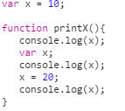
Hoisting

Slide 7
Objects
Reference
Combination of Key & Value
Different ways to create an object
Add/update/delete/loop an object
Object.keys

Slide 8
Array Methods
forEach
map
filter
push
pop
shift
unshift
slice
splice
every
some
fill
reverse
sort
concat
join
indexOf
lastIndex

Slide 9


Call vs Apply vs Bind
Used to call a method with external context
.call(context, arg1, arg2,...)
.apply(context, [arg1, arg2,...])
bind(context, arg1, arg2,...)
- returns a function , which can be executed later for result

Slide 10
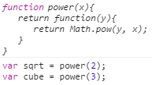

Closure
Inner function maintain the scope of outer/parent function

Slide 11
Synchronous vs Asynchronous Ajax
- Synchronous: Wait for the response (page become unresponsive until you receive the data) - Asynchronous: Will not wait for a response (will be handled with promises or callback)

Slide 12
Promise
- Used for deferred and asynchronous computations. - Represents an operation that hasn't completed yet, but is expected in the future

Slide 13
Why AngularJS
Structure, Quality and Organization
Lightweight ( < 36KB compressed and minified)
Free
Separation of concern
Modularity
Extensibility & Maintainability
Reusable Components

Slide 14
Features of AngularJS
Two-way Data Binding
Directives – Extend HTML
MVW
Dependency Injection
Testing
Deep Linking (Map URL to route Definition)
Server-Side Communication

Slide 15
Power of Angular
<html ng-app>
<head>
<title>Simple Addition Program</title>
<script src='angular.js'></script>
</head>
<body>
<input type=”number” ng-model=”x”>
<input type=”number” ng-model=”y”>
<div >Result: {{x+y}}</div>
</body>
</html>

Slide 16
Hello HTML
<p>Hello World!</p>

Slide 17
Hello Javascript
<p id="greeting1"></p>
<script>
var isIE = document.attachEvent;
var addListener = isIE
? function(e, t, fn) {
e.attachEvent('on' + t, fn);}
: function(e, t, fn) {
e.addEventListener(t, fn, false);};
addListener(document, 'load', function(){
var greeting = document.getElementById('greeting1');
if (isIE) {
greeting.innerText = 'Hello World!';
} else {
greeting.textContent = 'Hello World!';
}
});
</script>

Slide 18
Hello JQuery
<p id="greeting2"></p>
<script>
$(function(){
$('#greeting2').text('Hello World!');
});
</script>

Slide 19
Hello AngularJS
<p ng-init="greeting = 'Hello World!'">{{greeting}}</p>

Slide 20
Expressions
Expressions allow you to execute some computation in order to return a desired value.
{{ 1 + 1 }}
{{ 946757880 | date }}
{{ user.name }}
you shouldn’t use expressions to implement any higher-level logic.

Slide 21
Module
Define a module:
Define a module with dependencies on other modules:
Get an existing module:
var module = angular.module('myModule', []);
var module = angular.module('myModule', ['otherModule']);
var module = angular.module('myModule');

Slide 22
Module Phases
var module = angular.module('myModule', []); module.config([function() { alert('I run first'); }]); module.run([function() { alert('I run second'); }]);

Slide 23
Bootstrapping
Auto bootstrapping
<body ng-app=”module_name”></body>
Manual bootstrapping
angular.bootstrap(<dom:Object>, ['module_name']);

Slide 24
Controller
var myApp = angular.module('myApp',[]);
myApp.controller('GreetingController', ['$scope', function($scope) {
$scope.greeting = 'Hola!';
}]);
The $scope variable – Link your controllers and view

Slide 25
Directives
Directives are markers (such as attributes, tags, and class names) that tell AngularJS to attach a given behavior to a DOM element (or transform it, replace it, etc.)
Some angular directives
The ng-app - Bootstrapping your app and defining its scope.
The ng-controller - defines which controller will be in charge of your view.
The ng-repeat - Allows for looping through collections
ng-show, ng-hide, ng-if, ng-switch …..

Slide 26
Directives as Components
<rating max='5' model='stars.average'>
<tabs>
<tab title='Active tab' view='...'>
<tab title='Inactive tab' view='...'>
</tabs>
<tooltip content='messages.tip1'>

Slide 27
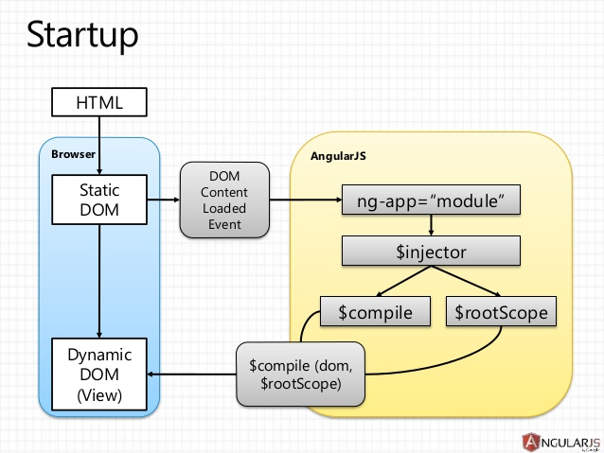
Architecture

Slide 28
Beginner
Module
Controller
Expressions
In-built Services
Custom services
Dependency injection
In-built directives
In-built filters
Event Binding
Data binding
Templates
Using $http service
Basic routing

Slide 29
Intermediate
Modularizing the application
communication between Controllers
Properly using factory, service, provider, value, constant, decorators
Creating custom directives
Creating custom filters
Using config, run blocks
Using $compile, $parse, $interpolate services
Understanding $watch, $watchCollection, $watchGroup
Template cache
Using $resource service
Using Promises ($q service)
ui-router
Form validation
Unit testing with karma/jasmine

Slide 30
Expert
Internationalisation
Using interceptors
Writing configurable/reusable services
Writing reusable components with directives
CORS
Single binding
Reducing $watchers
Writing E2E testing with protractor
Follow AngularJs good practice by Johnpapa
https://github.com/johnpapa/angular-styleguide/blob/master/a1/README.md

Slide 31
Popular Application Built on Angular
YouTube on PS3
weather.com
freelancer.com
netflix.com
angularjs.org
istockphoto.com

